Slide 1


Slide 2

مدیریت استراتژیک فناوری اطلاعات تحلیل و طراحی سیستم های اطلاعاتی
تهیه و تنظیم:
رضا میرزاباقری

Slide 3
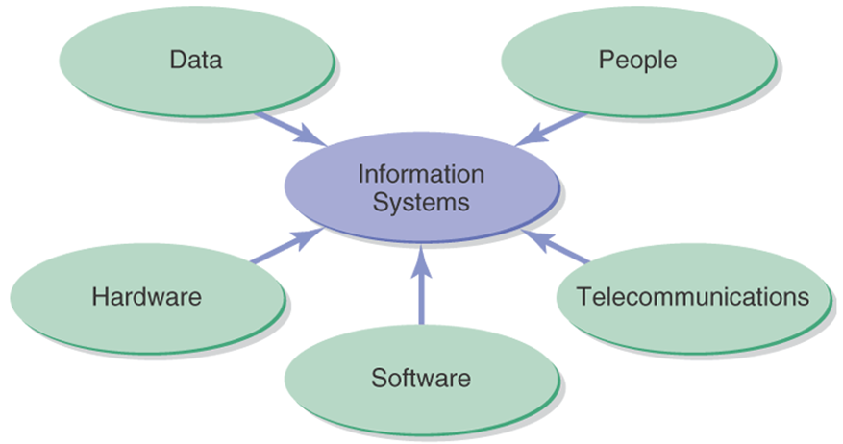
Key Elements of Information Systems

Slide 4
Data
Data: raw material, unformatted information
Information: processed data (meaningful)
Knowledge: understanding relationships between pieces of information
Wisdom: knowledge accumulated and applied
Notes:
حکمت: دانش انباشته شده و کاربردی

Slide 5
Technology and Information Systems
Computer-Based Information Systems
One type of technology
Technology – any mechanical and/or electrical means to supplement, extend, or replace human activity
Information Technology (IT) – machine technology controlled by or using information
The goal of IS is to provide useful data to users
IS can be local or global, organizational or enterprise-wide

Slide 6
IS Managerial Personnel
CIO
IS director
Account Executive
Info Center Manager
Development Manager
Project Manager
Maintenance Manager
Systems Manager
IS planning Manager
Operations Manager
Programming Manager
Systems Programming Manager
Manager of Emerging Technologies
Telecommunications Manager
Network Manager
Database Administrator
Auditing or Computer Security Manager
Quality Assurance Manager
Webmaster

Slide 7
Integrating Skills and Knowledge
Technology
hardware, software, networking
Business
business, management, social, communications
Systems
Integration, development methods, critical thinking, problem solving

Slide 8
The Benefit of Tech in Orgs
Benefits of centralized IS function
Coordinated planning
Consistent management
Systems compatibility and connectivity

Slide 9
Why Use Information Systems?
Automating:
doing things faster
Organizational learning:
doing things better
Supporting Strategy: doing things smarter
Create a vision
Create a standard
Reaching the goal

Slide 10
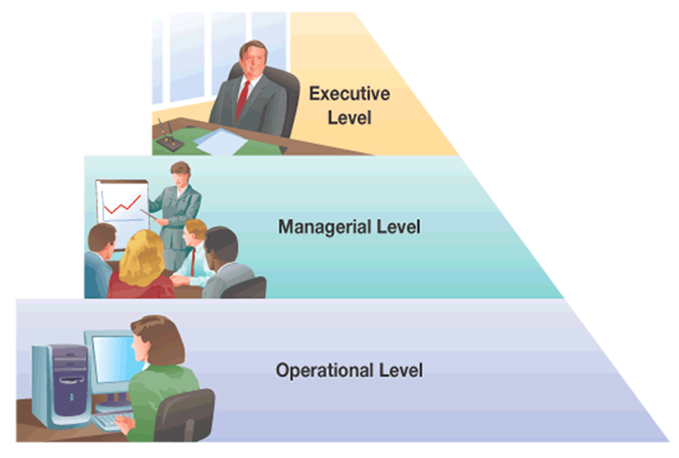
Decision-Making Levels of an Org

Slide 11
Decision-Making Levels of an Organization
Executive level (top)
Long-term decisions
Unstructured decisions
Managerial level (middle)
Decisions covering weeks and months
Semi-structured decisions
Operational level (bottom)
Day-to-day decisions
Structured decisions

Slide 12
General Types of Information Systems
Transaction Processing Systems (TPSs)
Transactions
Used at Operational level of the organization
Goal: to automate repetitive information processing activities
Increase speed
Increase accuracy
Greater efficiency

Slide 13
General Types of Information Systems
Data input
Manual data entry
Semiautomated data entry
Fully automated data entry
Examples:
Payroll
Sales and ordering
Inventory
Purchasing, receiving, shipping
Accounts payable and receivable

Slide 14
General Types of Information Systems
Management Information Systems (MISs)
Two Types:
Management of IS in organizations
Specific information systems for mid-level managers
Used at managerial level of the organization

Slide 15
General Types of Information Systems
Management Information Systems (MISs)
Examples:
Sales forecasting
Financial management and forecasting
Manufacturing planning and scheduling
Inventory management and planning
Advertising and product pricing

Slide 16
General Types of Information Systems
Executive Information Systems (EISs)
Used at executive level of the organization
Highly aggregated form
Data types
Soft data – news and non analytical data
Hard data – facts and numbers

Slide 17
General Types of Information Systems
Executive Information Systems (EISs)
Examples:
Executive-level decision making
Long-range and strategic planning
Monitoring internal and external events
Crisis management
Staffing and labor relations

Slide 18
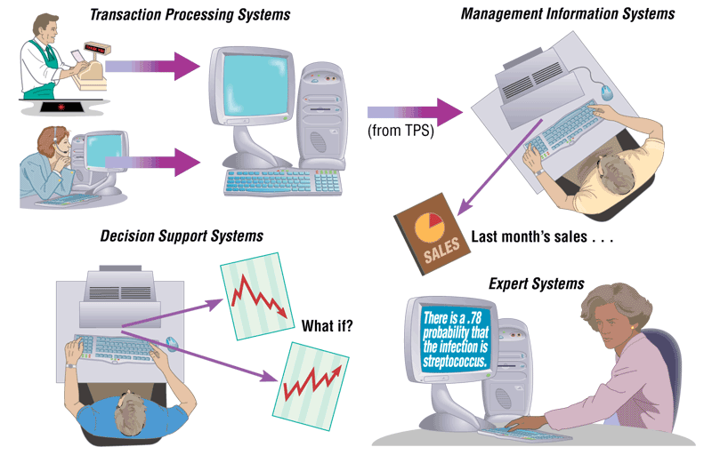
1.18

Slide 19
General Types of Information Systems
Decision Support Systems (DSSs)
Designed to support organizational decision making
“What-if” analysis
Example of a DSS tool: Microsoft Excel
Text and graphs
Models for each of the functional areas
Accounting, finance, personnel, etc.

Slide 20
General Types of Information Systems
Expert Systems (ESs)
Mimics human expertise by manipulating knowledge
Rules (If-then)
Inference

Slide 21
General Types of Information Systems
Office Automation Systems (OASs)
Examples:
Communicating and scheduling
Document preparation
Analyzing data
Consolidating information

Slide 22
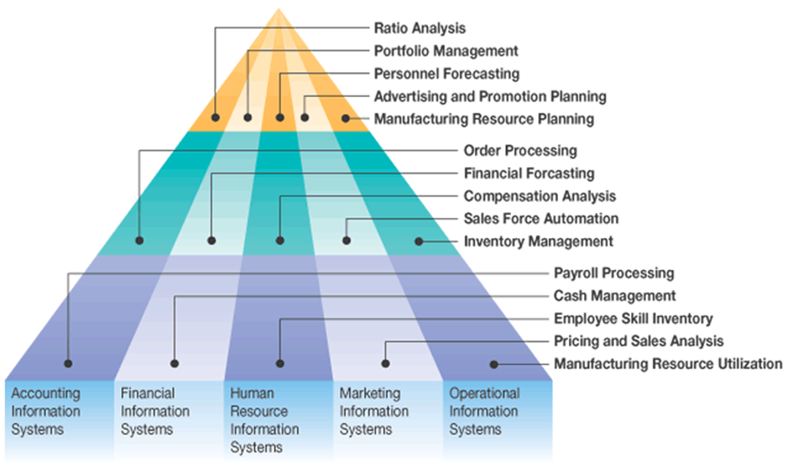
Functional Area of IS

Slide 23
Types of Global IS
Global Information Systems
International IS
Transnational IS
Multinational IS
Global IS

Slide 24
Enterprise Systems
Enterprise systems
Also known as enterprise-wide information systems
Information systems that allow companies to integrate information across operations on a company-wide basis

Slide 25
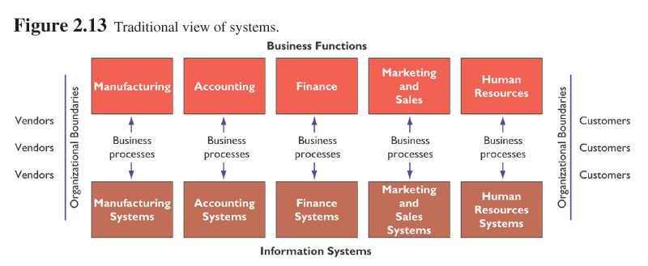
Before an entreprise system

Slide 26
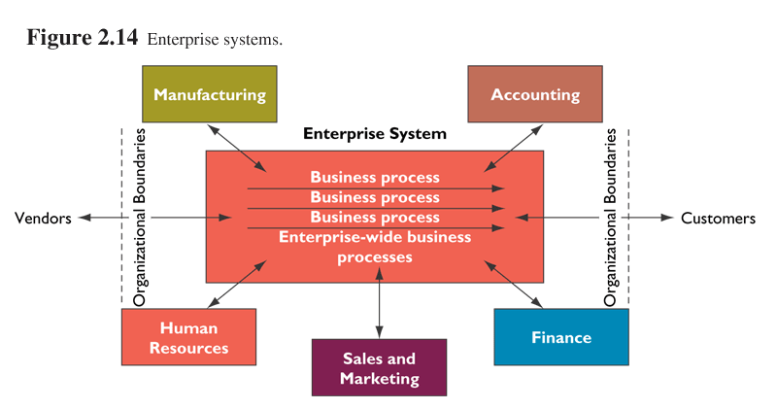
With an entreprise sytem

Slide 27
Types of Enterprise Systems
Packaged applications
Custom applications
Stand-alone applications

Slide 28
Types of Enterprise Systems
Enterprise Resource Planning
Integrated applications
ERP systems
Baan
Oracle
PeopleSoft
SAP (Systems Applications and Products)

Slide 29
Types of Enterprise Systems
Customer Relationship Management (CRM)
Sales Force Automation (SFA)
New opportunities for competitive advantage
Examples:
MGM
American Airlines
Marriott International

Slide 30
Types of Enterprise Systems
Supply Chain Management (SCM)
Supply chain – the producers of supplies that a company uses
Supply network

Slide 31
The Need for Structured Systems Development
Systems analysis and design is the process of:
Designing
Building
And maintaining information systems

Slide 32
The Need for Structured Systems Development
Options for Obtaining Information Systems
Build your own
Buy a prepackaged system
Outsource development to a 3rd party
End user development

Slide 33
The Need for Structured Systems Development
Information Systems Development in Action
Breaking large complex problems into manageable pieces
Decomposing large, complex problems

Slide 34
The Need for Structured Systems Development
System Construction Process
Identify a large IT problem to solve
Break the large problem into several smaller, more manageable pieces
Translate each “piece” (small problem) into computer programs
Piece together each program into an overall comprehensive IS that solves the problem

Slide 35
Information Systems Analysis and Design
Systems Analyst performs analysis and design based upon:
Understanding of organization’s objectives, structure and processes
Knowledge of how to exploit information technology for advantage

Slide 36
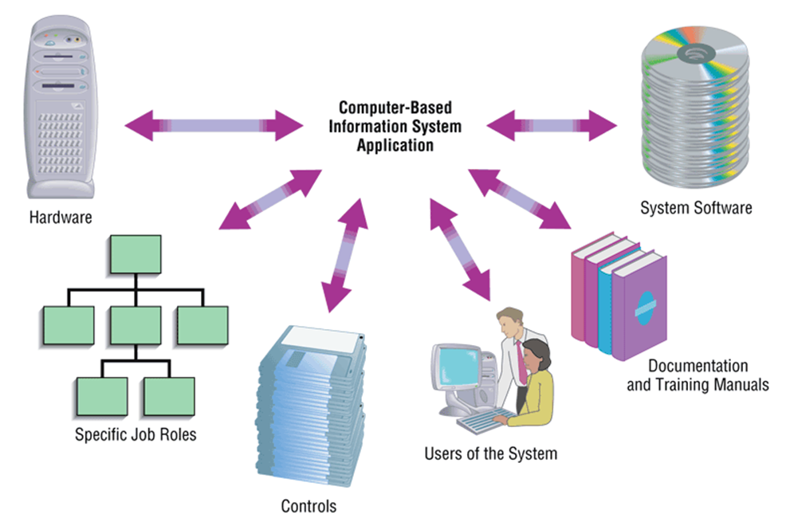
Component of IS Applications

Slide 37
A Modern Approach to Systems Analysis and Design
Systems Integration
Allows hardware and software from different vendors to work together
Enables procedural language systems to work with visual programming systems
Visual programming environment uses client/server model

Slide 38
Data and Processes
Three key components of an information system
Data
Data Flows
Processing Logic
Data vs. Information
Data
Raw facts
Information
Derived from data
Organized in a manner that humans can
understand

Slide 39
Data and Processes
Data
Understanding the source and use of data is key to good system design
Various techniques are used to describe data and the relationship amongst data
Data Flows
Groups of data that move and flow through the system
Include description of sources and destination for each data flow
Processing Logic
Describe steps that transform data and events that trigger the steps

Slide 40
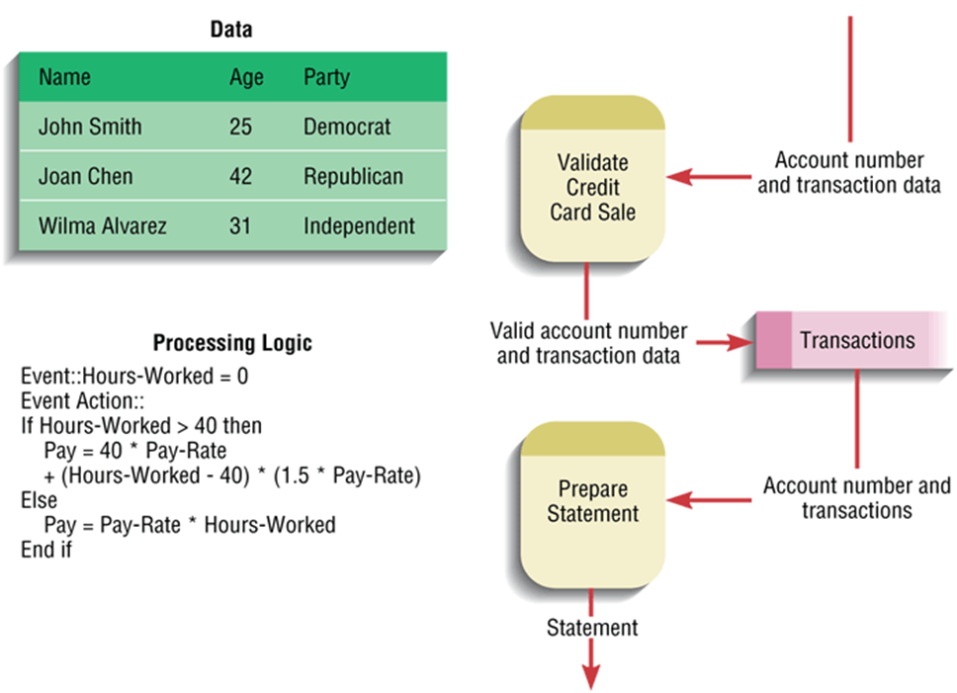

Slide 41
Approaches to Systems Development
Process-Oriented Approach
Focus is on flow, use and transformation of data in an information system
Involves creating graphical representations such as data flow diagrams and charts
Data are tracked from sources, through intermediate steps and to final destinations
Natural structure of data is not specified

Slide 42
Approaches to Systems Development (2)
Data-Oriented Approach
Represents ideal organization of data, independent of where and how data are used
Data model describes kinds of data and business relationships among the data
Business rules depict how organization captures and processes the data

Slide 43
Role of the Systems Analyst
Study problems and needs of an organization
Determine best approach to improving organization through use of:
People
Methods
Information technology
Help system users and managers define their requirements for new or enhanced systems

Slide 44
Role of the Systems Analyst
Assess options for system implementation
In-house development
Outsourced development
Outsourced development and operation
Commercial application
For in-house projects, work on a team of analysts and developers

Slide 45
Skills of a Successful Systems Analyst
Analytical
Understanding of organizations
Problem-solving skills
System thinking
Technical
Understanding of potential and limitations of technology
Managerial
Ability to manage projects, resources, risk and change
Interpersonal
Effective written and oral communication skills

Slide 46
Systems Development Life Cycle
System Development Methodology
Standard process followed in an organization
Consists of:
Analysis
Design
Implementation
Maintenance

Slide 47
Systems Development Life Cycle
Series of steps used to manage the phases of development for an information system
Consists of four phases:
Planning and Selection
Analysis
Design
Implementation and Operation

Slide 48
Systems Development Life Cycle
Phases are not necessarily sequential
Each phase has a specific outcome and deliverable
Individual companies use customized life cycle

Slide 49
Phases of the Systems Development Life Cycle
Systems Planning and Selection
Two Main Activities
Identification of need
Investigation and determination of scope
Systems Analysis
Study of current procedures and information systems
Determine requirements
Generate alternative designs
Compare alternatives
Recommend best alternative

Slide 50
Systems Development Life Cycle
System Design
Logical Design
Physical Design
Implementation and Operation
Implementation
Hardware and software installation
Programming
User Training
Documentation
Operation

Slide 51
SDLC
Planning and Selection
Analysis
Design
Implementation and Operation

Slide 52


